Slide 1
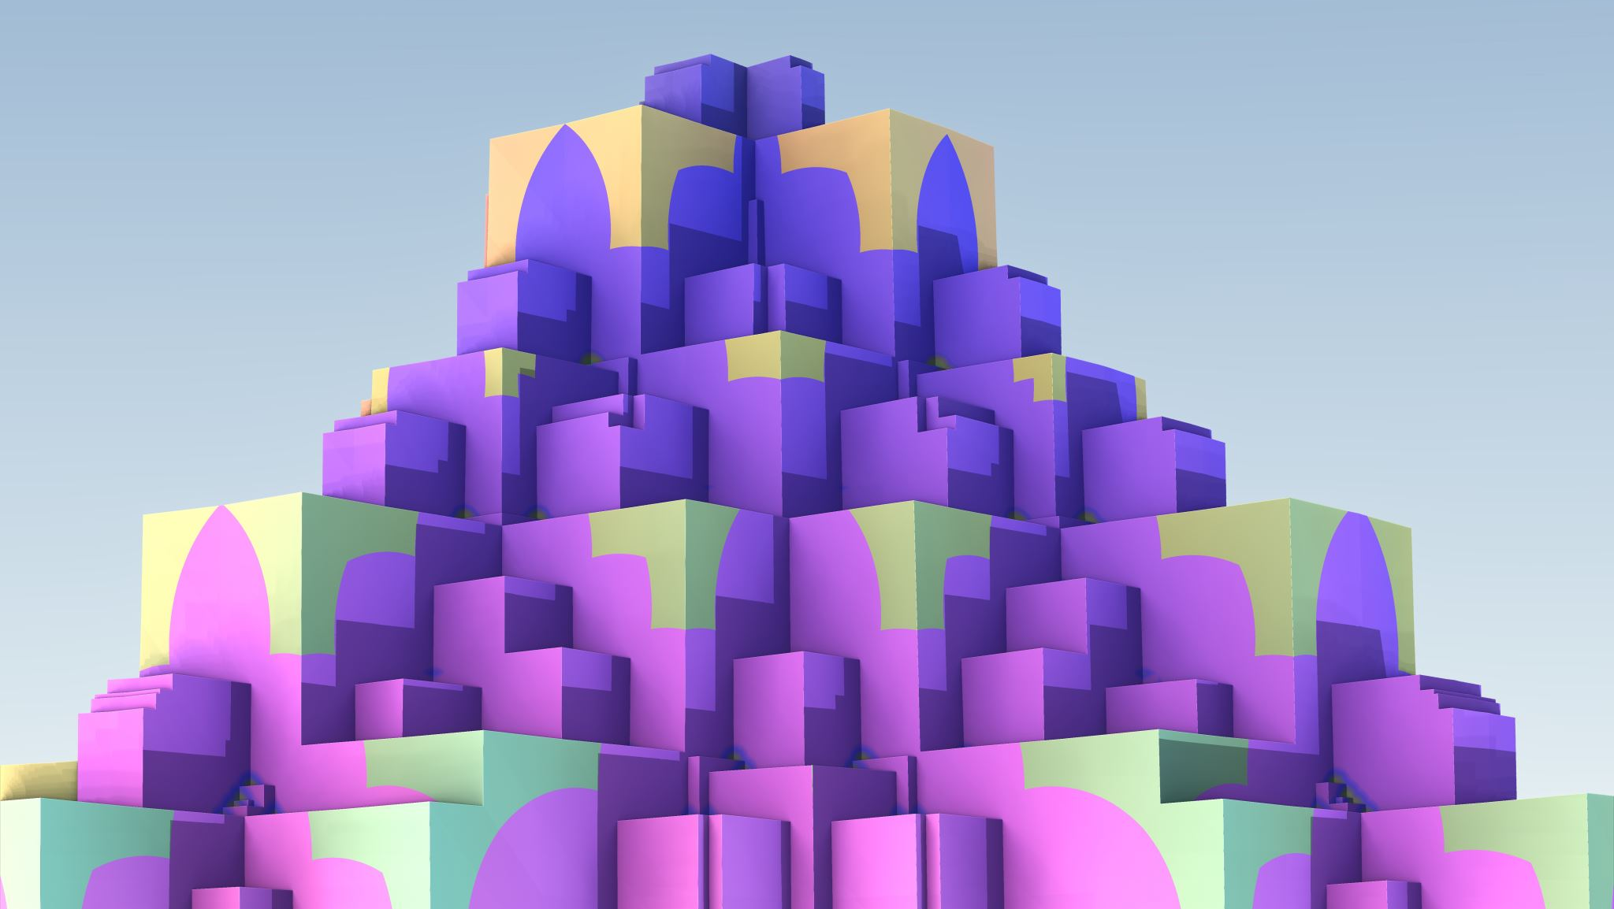
Praxis Approach
Design

Slide 2
LLM Approach
Document
Window
Window
Document
LLM
LLM
LLM can process the entire document for documents that are smaller than its window
LLM can only process a subset of the document or documents that extend beyond its window

Slide 3
Attention and Focus
Vehicles
Vehicles
Weather
Weather
Animals
Animals
Attention looks at everything. It identifies how similar a cat is to a car.
Focus looks at a subset and only pays attention to that subset. Is this cat in front of me dangerous?

Slide 4
Proposed Approach
Document
Partition Document into Chunks
Chunks
LLM / Prompt
Knowledge Graphs
LLM / Prompt
Grouped Knowledge Graphs
Process a document or documents into chunks. This will require multiple passes to ensure chunk boundaries are fully addressed.
Process Chunks into one Knowledge Graph per Entity
Identify type of each entity and group together

Slide 5
Proposed Architecture
D – Data
KG – Knowledge Graph
P – Processing
(KG2)
Long-Term Memory
(P5)
Long Term Memory Processing
(D1)
Documents
Out of scope
(P1) Document Processing
(P4)
Long Term Memory Formation
(D3)
Responses
Out of scope
(P6)
Response Processing
Agent
(D2)
Queries
(P3)
Input Processing
(KG1)
Short-Term Memory
(P2)
Query Processing

Slide 6
Proposed Architecture
Short Term Memory
Long Term Memory
Entity 1
Entity 2
Entity 3
Entity 1
Entity 2
Type List
Entity 3

Slide 7
Notes
What is the validation?
Introduce errors to measure how well it does
Introducing errors into documents.
Start with smaller documents.
Partition the document.
Errors within a partition
Errors between partitions
Metrics
Number of chapters
Number of words
How many pages are processed
How long does it take?
How well does it scale?
Top non noise words
To do
Continue Research – focus is on Knowledge Graphs
Continue Methodology
Update chapter 1

Slide 8
Data Definitions
ID | Item | Use | Notes
D1 | Documents | Word documents stored and ready for use.
D2 | Queries | These are questions about the documents that have been processed into long term memory.
D3 | Response

Slide 9
Knowledge Graph Definitions
ID | Item | Use | Notes
KG1 | Short-Term Memory | Consolidation of knowledge graphs from all input processing. | I am not sure if it is one graph, one graph per input, or one graph per type. I am not sure how to store it. How do I relate back to the document?
KG2 | Long-Term Memory | Consolidation of knowledge graphs from all processing. | I am not sure if it is one graph, one graph per input, or one graph per type. I am not sure how to store it.

Slide 10
Processing Definitions
ID | Item | Use | Notes
P1 | Document Processing | Process a document into chunks that can be processed by the Input Processing. | Each run add one or more knowledge graphs into the short-term memory. A first cut of the type is assigned. It needs to store the source with the knowledge graph.
P2 | Query Processing | Prepare the query for Input Processing.
P3 | Input Processing | Using a prompt like: Process this input into a knowledge graph and assign attributes to each entity. There should be a type hierarchy. A first cut of the type should be assigned. | A future direction would be to have an LLM that specifically knows how to do this task.

Slide 11
Processing Definitions
ID | Item | Use | Notes
P4 | Long Term Memory Formation | A prompt like: Review the knowledge graph in the short-term memory and integrate it into the long-term memory resolving any duplicates and consolidating into a consistent type hierarchy. | The knowledge graphs in the short-term memory are consolidated into the long-term memory. They are then removed from short term memory. This is run periodically. Could be when input is quiet for a period or every hour.
P5 | Long Term Memory Processing | A prompt like: Review all nodes of the knowledge graphs and look for ways to improve them by creating new relationships, adding attributes, making similar things similar. Replace with the better version. | Runs once a day to keep the long-term memory well organized.

Slide 12
Processing Definitions
ID | Item | Use | Notes
P6 | Response Processing Agent | An agent that reviews the short-term memory looking for things that it can respond to. Uses a prompt like: Review the short-term memory and look for items that you can respond to. Use the long-term memory if needed.

Slide 13
Processing Steps
Load
Load up one or more documents
Start
Start the document processing (How?)
Wait
Give it time for background processes to work
Query
Issue prompts to ask questions

Slide 14
Notes
Which LLM should I use?
What structure should the knowledge graph be? I am thinking XML.
How can I make the knowledge graph more like a Frame with Slots?
Should the knowledge graph be stored in OS files or a structured storage mechanism?
I would like to store everything in a Neural Network. Could be a future direction.

Slide 15
Future Directions
Create task specific LLMs
Store Knowledge Graphs in Neural Networks
Make Knowledge Graphs into Frames

